Slide 1
Inventory Control Dashboard
File created on: 11/28/2023 3:17:07 PM

Slide 2
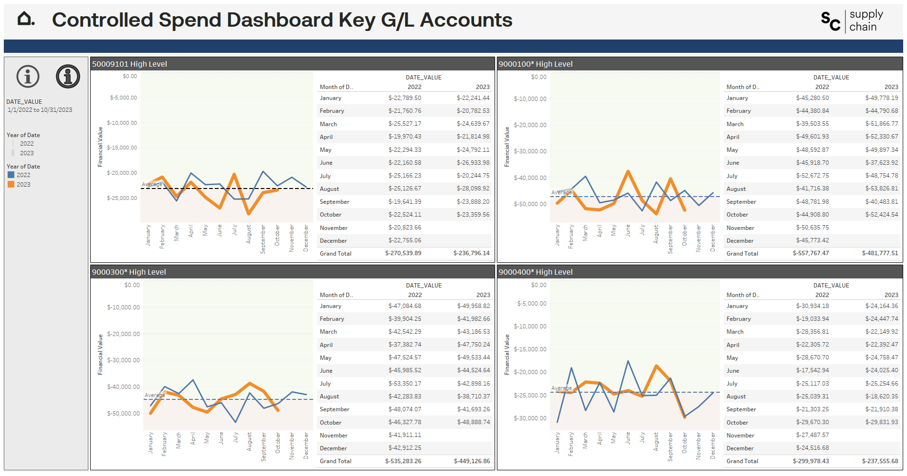

Slide 3
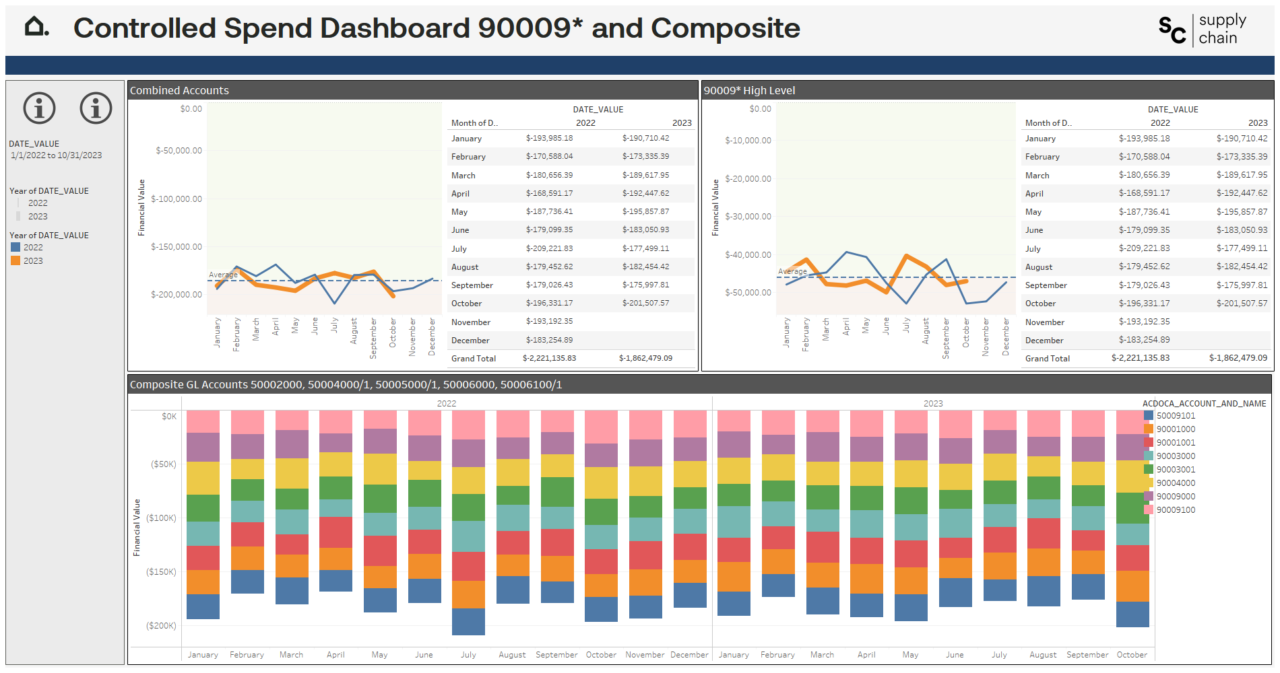

Slide 4
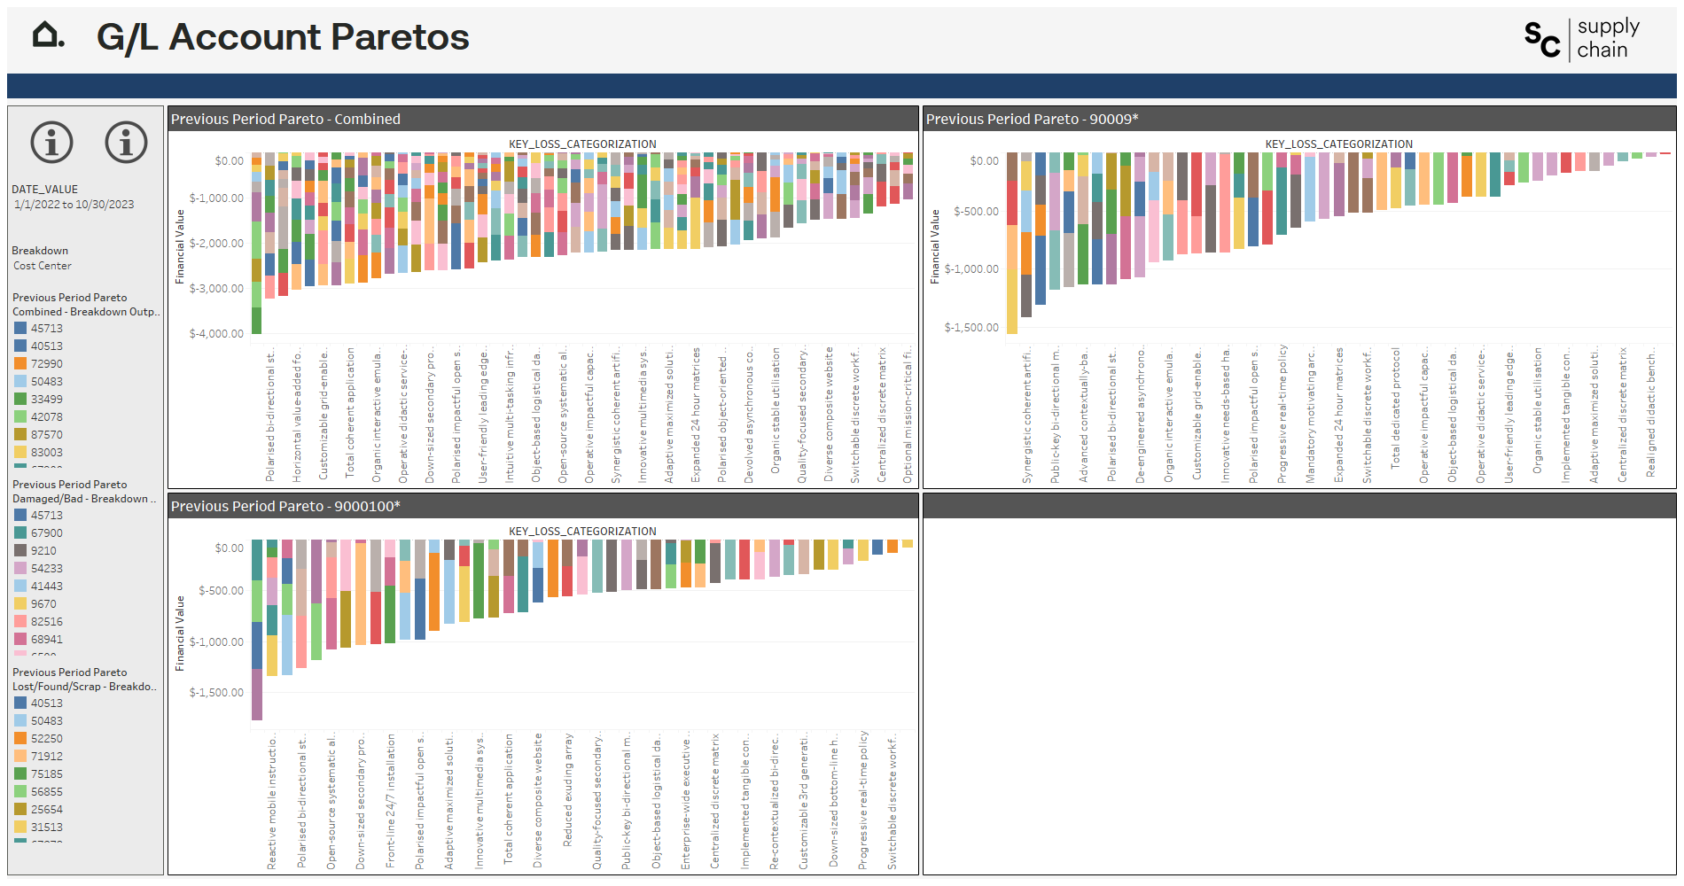

Slide 5
